Slide 1
CIPHER BLEND
-Cryptographic technique for communication system

Slide 2
CONTENTS
Abstract
Cryptography Definition
Merits and Demerits
Issues and Challenges in Communication System
Literature Survey
Vigenère Cipher
Polybius Cipher
Hybrid Cipher
Proposed Work
Conclusion
References

Slide 3
ABSTRACT
Secure Communication of message from sender to receiver is one of the main security concern of Internet users across world.
It is because of the regular attacks and threats and most Important Data Privacy. In order to sort out these issues, we use cryptographic algorithm which encrypts data in some cipher and transfers it over the internet and again decrypted to original data.
Thus, lightweight cryptography methods are proposed to overcome many of the problems of conventional cryptography
Ciphers act as encapsulating system for message. Hybrid Algorithm will be formed from use of different types of ciphers.
The cryptosystem performs its encryption by encrypting the plaintext using Vigenère Cipher and further again processing though Polybius Cipher.

Slide 4
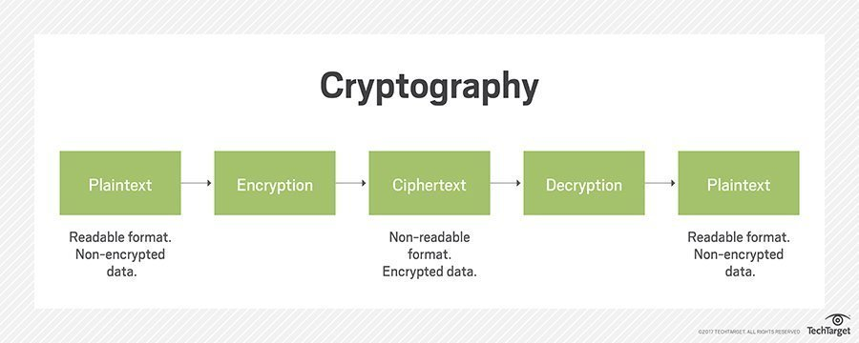
INTRODUCTION TO CRYPTOGRAPHY
Cryptography is the science of protecting information by transforming it into a secure format. This process, called encryption, has been used for centuries to prevent handwritten messages from being read by unintended recipients.
Today, cryptography is used to protect digital data. It is a division of computer science that focuses on transforming data into formats that cannot be recognized by unauthorized users.

Slide 5
MERITS AND DEMERITS
MERITS
Highly Secure
Confidentiality
Authentication
Data Integrity
Non-repudiation
DEMERITS
Limited use of hybrid algorithms.
Selective access control needs administrative procedures, not cryptography.
Cryptography is costly and time-consuming.
Limited deployment of systems through Deep Learning.

Slide 6
ISSUES AND CHALLENGES IN COMMUNICATION SYSTEM
State of Insecurity – Increase in Adaption and Development of fragmented attached attack on daily basis on communication system.
Data Replication – Re-writing and Copying of data from Back End server even It is protected by Data saving applications.
Sense of Message Stealing- Important Message of huge Key length stealing or blocking & Jamming of server.
New threats and Attacks such as Eavesdropping, DOS attack and kasiski attacks
Congestion – Message overlapping and re accessing receiver channel without their knowledge.
Wireless Spoofing attacks- attacker uses information obtained by a wireless sniffer to impersonate another machine on the network.

Slide 7
VIGENERE CIPHER
Vigenère Cipher is a method of encrypting alphabetic text. It uses a simple form of polyalphabetic substitution.
The encryption of the original text is done using the Vigenère square or Vigenère table.
The table consists of the alphabets written out 26 times in different rows, each alphabet shifted cyclically to the left compared to the previous alphabet, corresponding to the 26 possible Caesar Ciphers.
At different points in the encryption process, the cipher uses a different alphabet from one of the rows.
The alphabet used at each point depends on a repeating keyword.

Slide 8
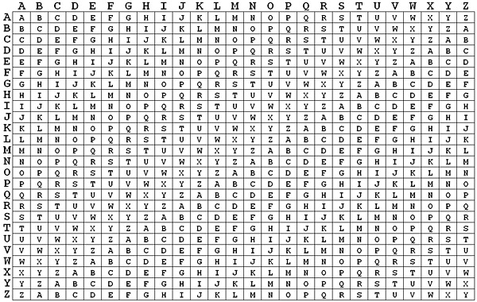
VIGENERE TABLE

Slide 9
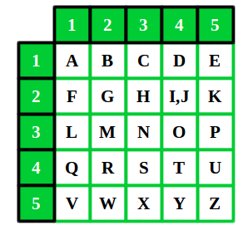
POLYBIUS CIPHER
A Polybius Square is a table that allows someone to convert letters into numbers. To make the encryption little harder, this table can be randomized and shared with the recipient.
In order to fit the 26 letters of the alphabet into the 25 cells created by the table, the letters ‘I’ and ‘J’ are usually combined into a single cell.

Slide 10
WORKING METHODOLOGY
The method employs use of both Vigenère Cipher and Polybius Square Cipher in its encryption process.
The ciphertext will first be operated on using Vigenère. A chosen key out of random will initiate the process.
At the end of the process, the resulting ciphertext then becomes a message as Input for the Polybius Square Cipher process.
This process will end up making the final ciphertext more difficult to be broken using existing cryptanalysis processes.
A software program will be written to demonstrate the effectiveness of the algorithm using Python programming language and cryptanalysis will be performed on the ciphertext.

Slide 11
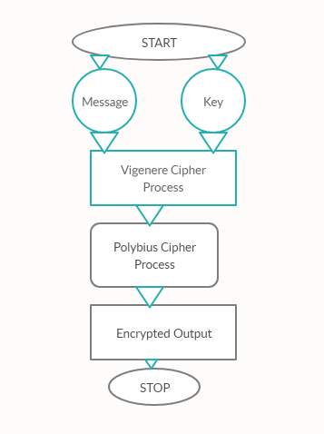
PICTORIAL VIEW

Slide 12
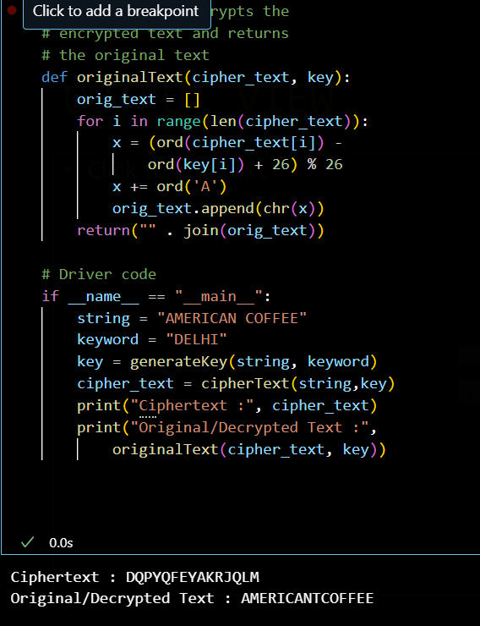
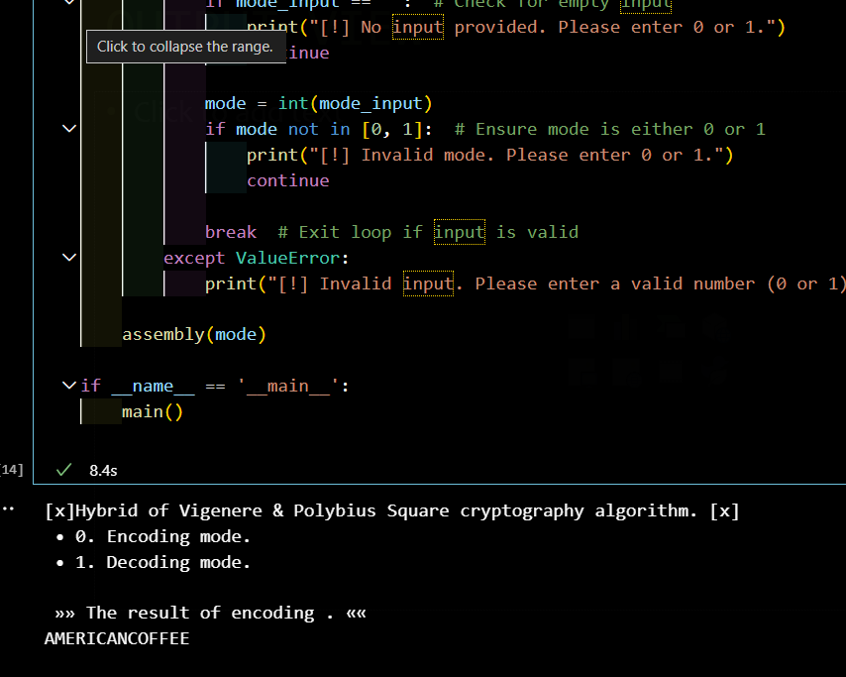
OUTPUT VIEW

Slide 13
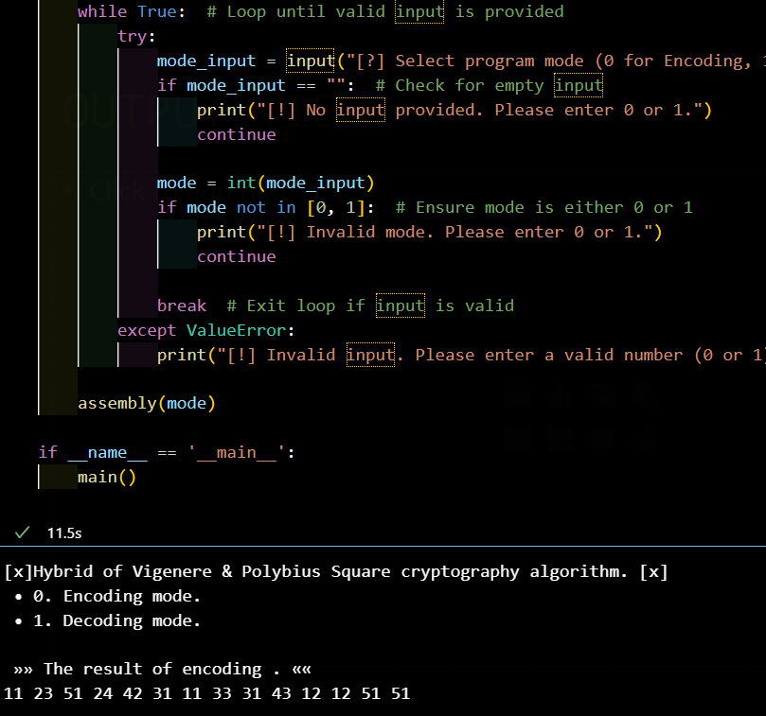
HYBRID MODEL
Hybrid Process though Combination of Vigenère and Polybius Square Cipher takes Encoding Mode where it governs on [A-Z] Alphabetic letters and Numerical Both in the System.
This Hybrid Cipher makes the System tough and unbreakable for any Assaults and attacks from Outside

Slide 14
CONCLUSION
Cryptography is the widely used method for the security of data. Vigenere cipher is one of the cryptographic method that is considered simplest and weakest due to many limitations.
To overcome the limitations of Vigenère cipher we proposed Summation of Polybius Cipher that makes much secure against Kasiski and Friedman attacks. Cryptanalysis, frequency analysis, pattern prediction and brute attack on proposed technique are also much difficult due to use of Combination of two Cipher for encryption.
Although there are many cryptographic methods but this domain still requires serious attention of research community for the improvement of data security. In future our aim is to provide validation of proposed approach by performing security and performance analysis.

Slide 15
REFERENCES
1. https://en.wikipedia.org/wiki/Vigen%C3%A8re_cipher
2. https://en.wikipedia.org/wiki/Polybius_square
3. Shivam Vatshayan (2020). Research paper on Design and analysis of hybrid cryptography models for communication system

